Slide 1



Evaluating and Optimizing Training and Interference Performances Between Variations of UNET Models for Nuclei Detection and Segmentation
APRIL 4, 2024
Presented by
Richard Dong & Yuliang (Chris) Xiao & Sylvia Xu

Slide 2

Introduction
Why do we need cell segmentation?

Slide 3
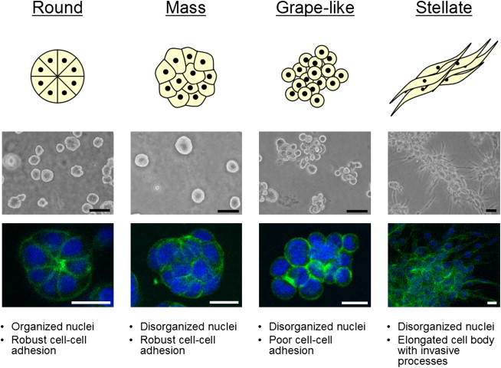
Cell morphology is highly related to cancer research
Kenney et al. (2007)Molecular Oncology
Notes:
https://www.sciencedirect.com/science/article/pii/S1574789107000075

Slide 4
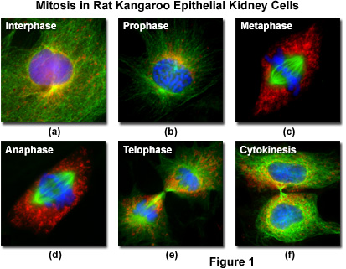
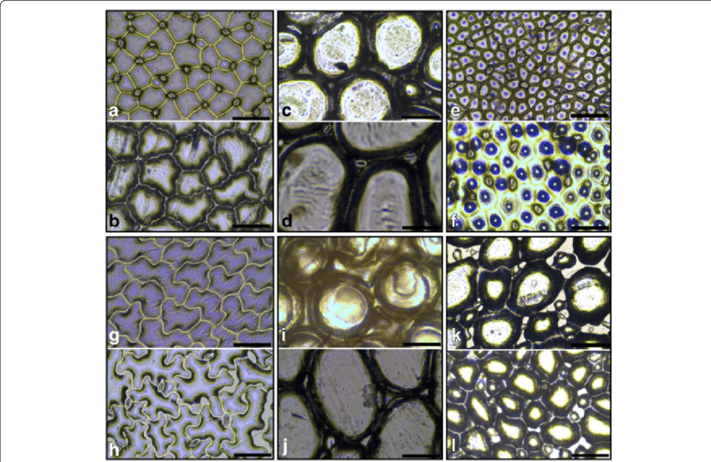
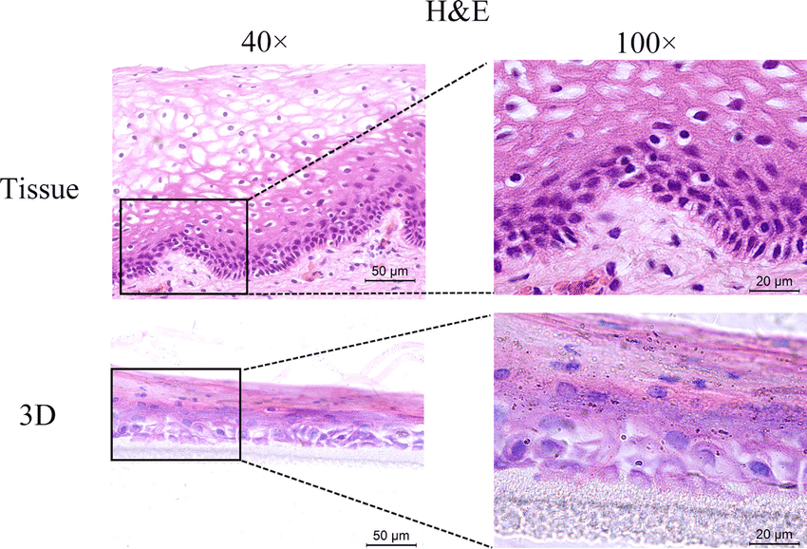
Microscope is the major contributor for cell visualization
National High Magnetic field library (2015)
Jooste et al. (2016) BMC Evolutionary Biology
Zhu et al. (2017) Oncotarget
Notes:
give examples of microscope images
https://micro.magnet.fsu.edu/cells/fluorescencemitosis/index.html
https://www.researchgate.net/figure/Light-microscope-photographs-depicting-different-epidermal-cell-types-observed-in_fig1_309577070
https://www.researchgate.net/figure/H-E-staining-of-the-original-vaginal-tissue-and-3D-cultures-The-HNVEC-cells-were_fig4_313033196

Slide 5
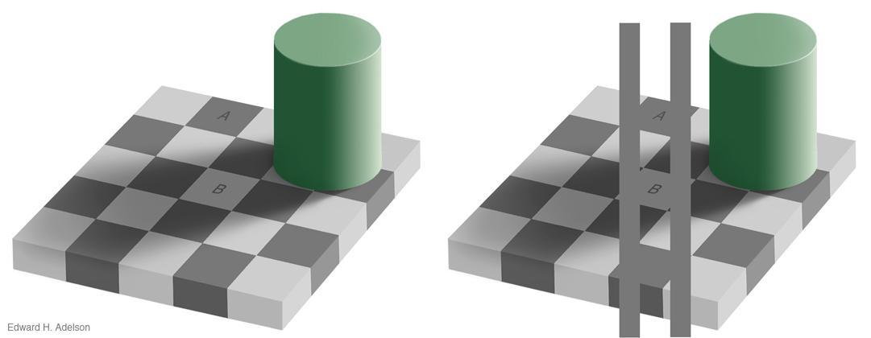
Problems
Hard to analyze large volume of data manually
Human vision might not identify some characteristics of cell edges and background efficiently

Slide 6
Problems
Hard to analyze large volume of data manually
Human vision might not identify some characteristics of cell edges and background efficiently

Slide 7
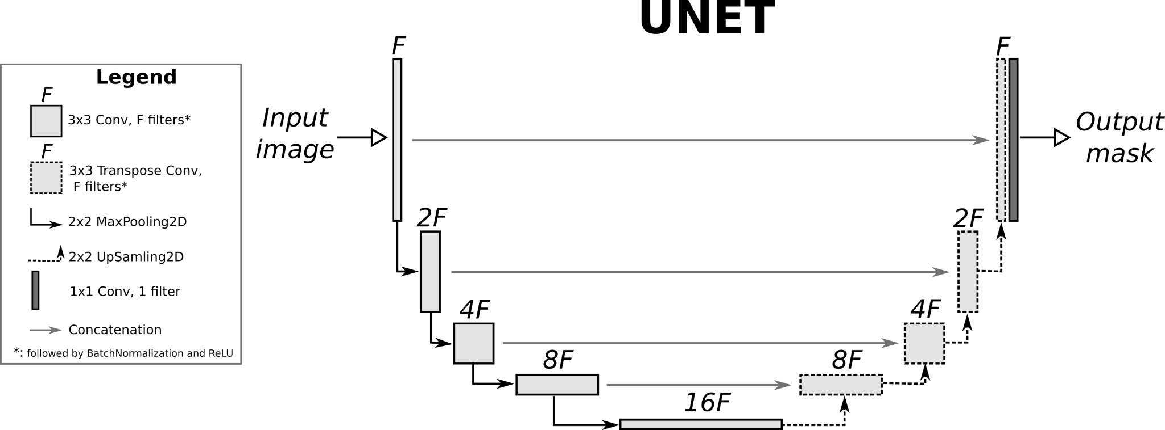
UNET and UNETR (transformer)
skip connection
Keras_UNET_segmentation(2019)Github
Notes:
https://nchlis.github.io/2019_10_30/page.html

Slide 8
Optimizer and learning rate scheduler
- Optimizer -
An algorithm used to adjust the parameters of a model during training to minimize the loss function
update actual parameters based on gradients and other additional parameters
- Learning rate scheduler -
A technique used to adjust learning rate based on predefined schedule
modify the learning rate over the course of training to improve convergence / stability / performance
Notes:
Start with ML or CNN?

Slide 9
Goal of this presentation
Provide a practical guide for choosing the most suited model architecture for future researchers who wish to train their own cell segmentation model.

Slide 10
Goal of this study
Aims of this study
Provide a practical guide for choosing the most suited model architecture for future researchers who wish to train their own cell segmentation model
Evaluate cell segmentation performance of UNET and UNETR
Compare the performances of models with and without the use of a learning rate scheduler and models with Adam/SGD

Slide 11
Materials and Methods
Dataset, Model Design, and Training Details

Slide 12
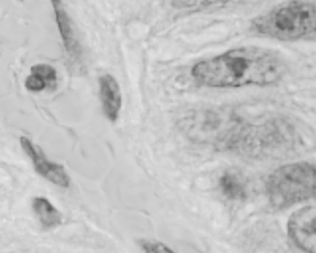
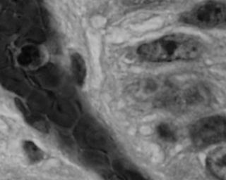
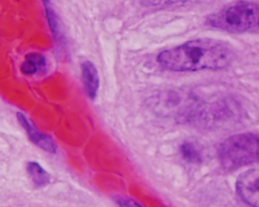
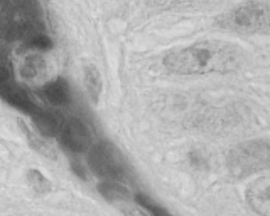

Data Preprocessing
Red Channel
Define Channel
Image: 4 channels (RGBA)
Mask: 1 channel (grayscale)
Unify Data Dimension (512 x 512)
Image => linear interpolation
Mask => nearest interpolation
Intensity Normalization
Min-max normalization
Scale the intensity within [0,1]
W = 512
Green Channel
=
H = 512
Blue Channel
Alpha Channel

Slide 13
Network Design
UNET
Layers: [16, 32, 64, 128, 256, 512]
Strides: 2
Kernel: 3 x 3
Activation: LeakyRelu
Normalization: batch
Dropout ratio: 0.2
UNETR
Feature size: 16
Hidden layers: 768
Number of attention heads: 12
Activation: LeakyRelu
Normalization: batch
Dropout ratio: 0.2

Slide 14
Optimizer and LR Scheduler
Adam Gradient Descent
Weight decay: 3e-5
Learning rate: 0.005
Stochastic Gradient Descent (nesterov momentum)
Weight decay: 3e-5
Learning rate: 0.005
Momentum factor: 0.99
Polynomial Learning Rate Decay
Decrease every epoch with an exponential power 0.9

Slide 15
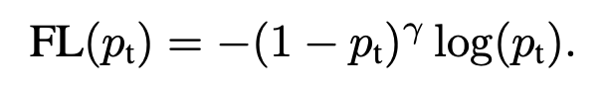
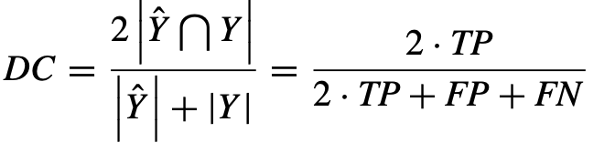
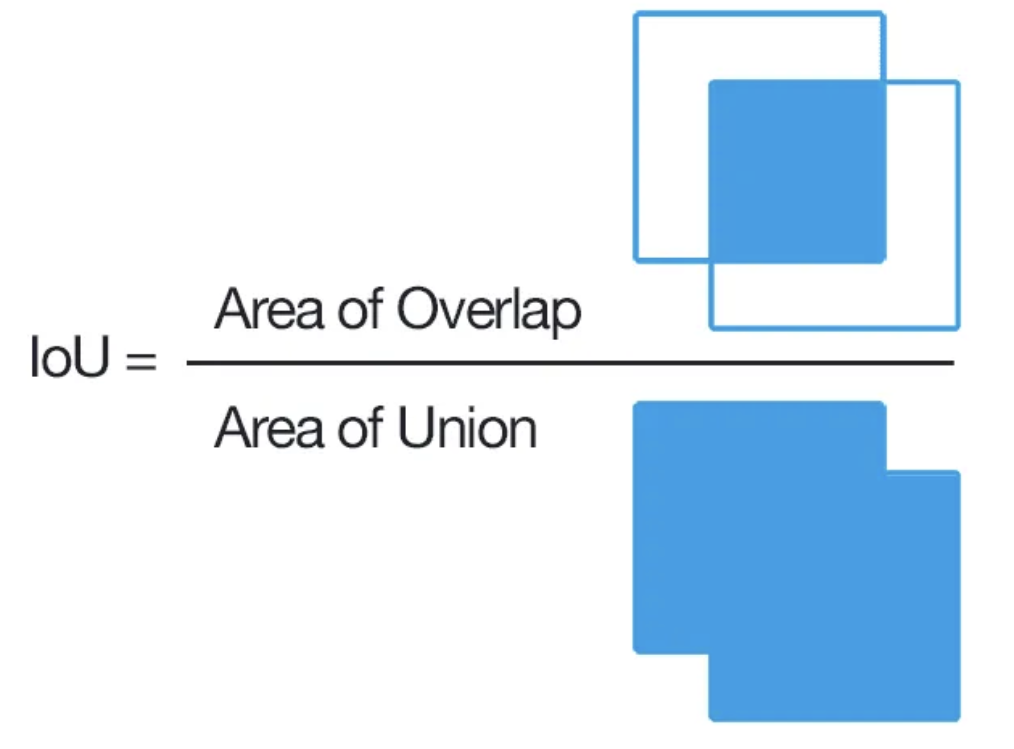
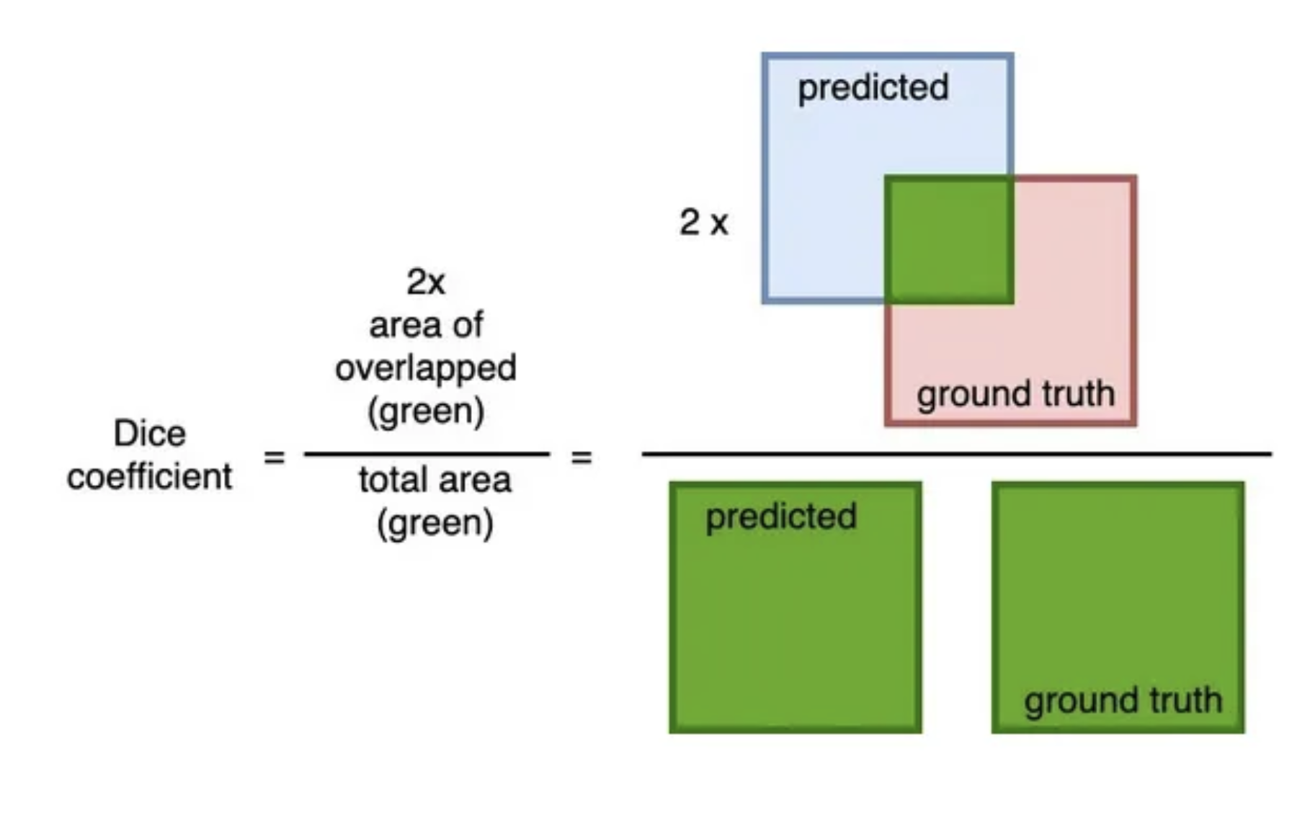
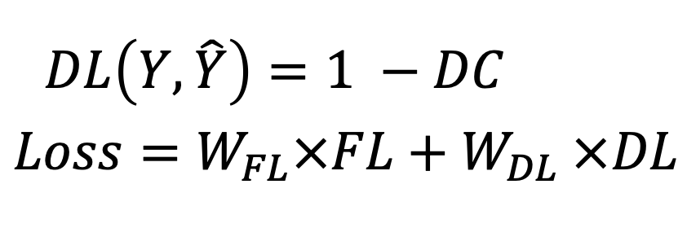
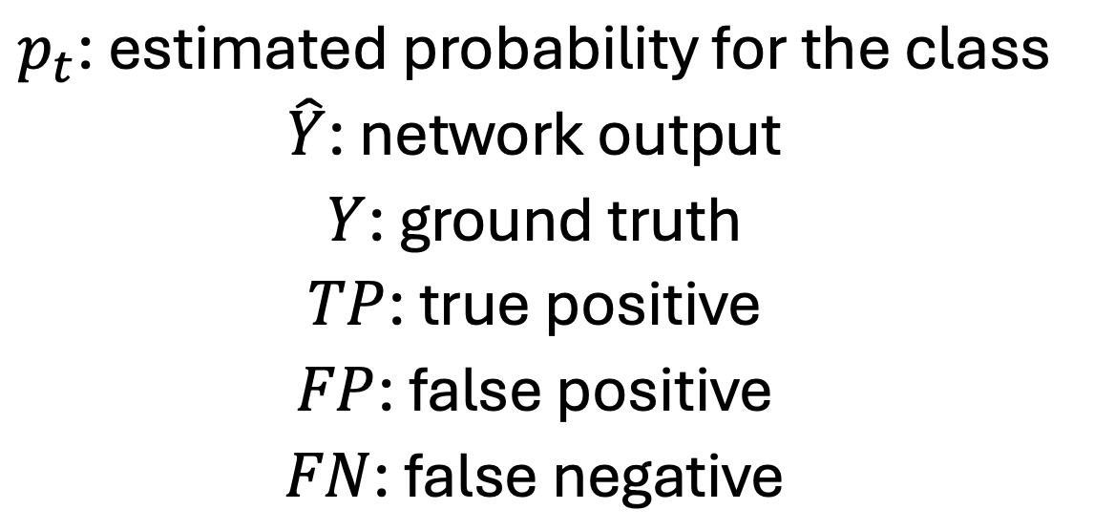
Evaluations
Dice + Focal Loss
Intersection over Union (IoU)
Dice Coefficient (DC)

Slide 16
Results & Discussion
Comparison of various model performances

Slide 17
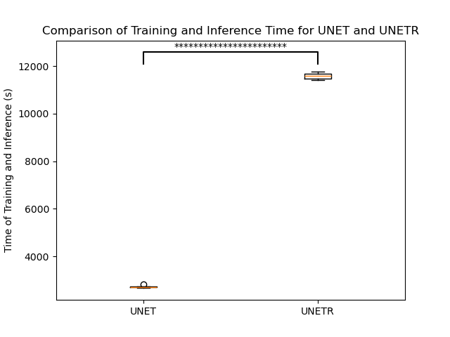
UNET requires significantly less time for training

Slide 18
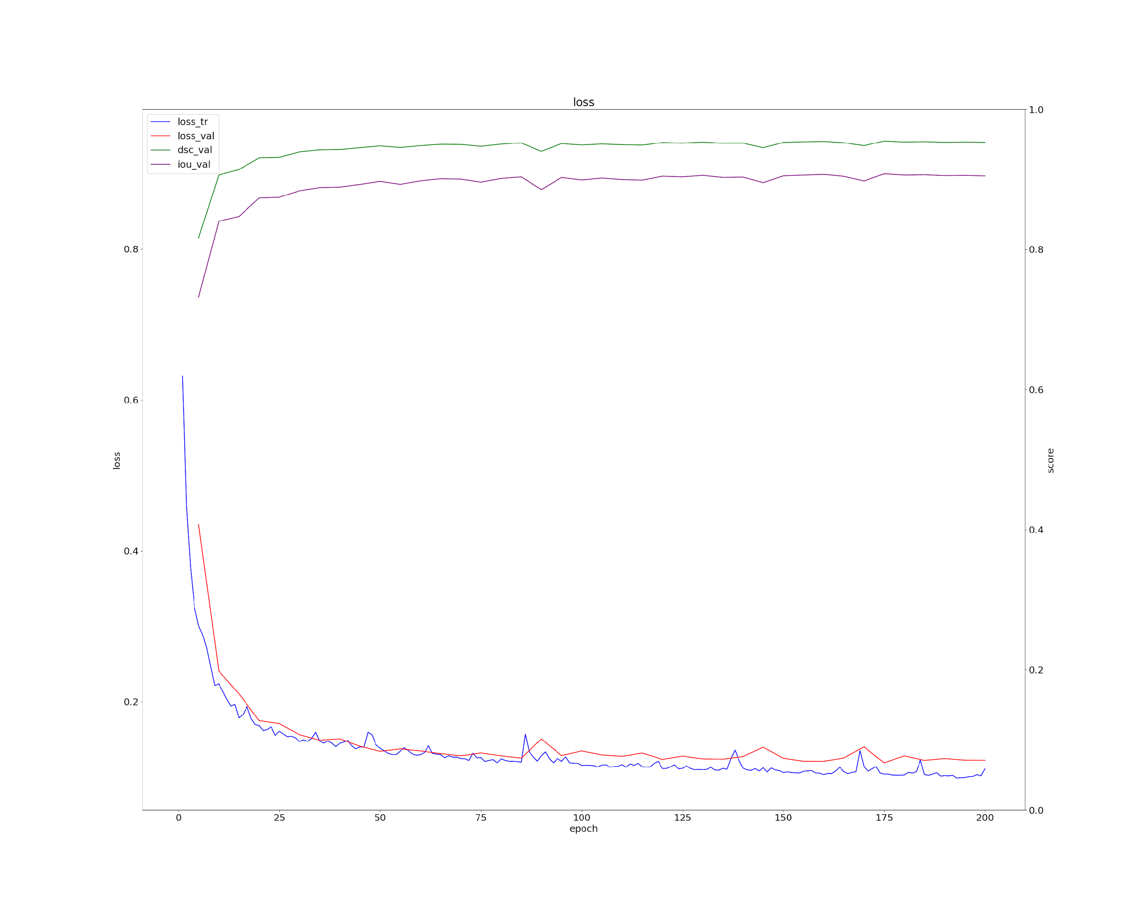
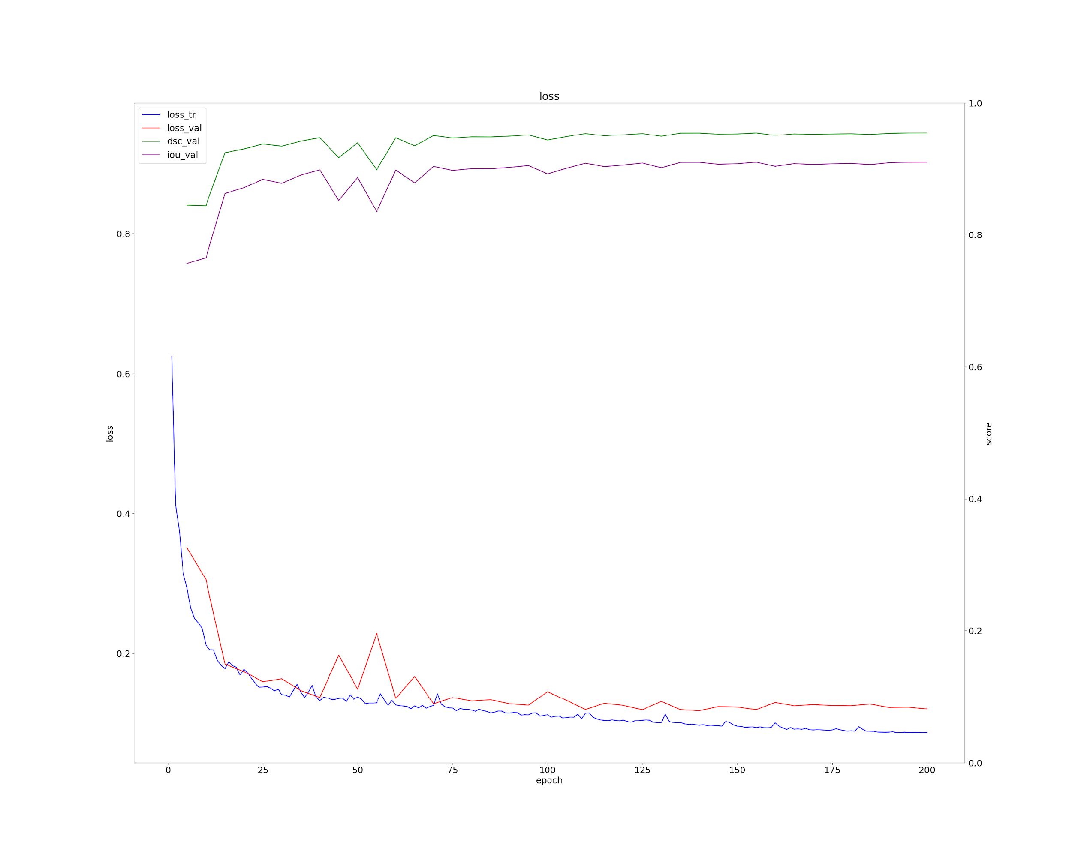
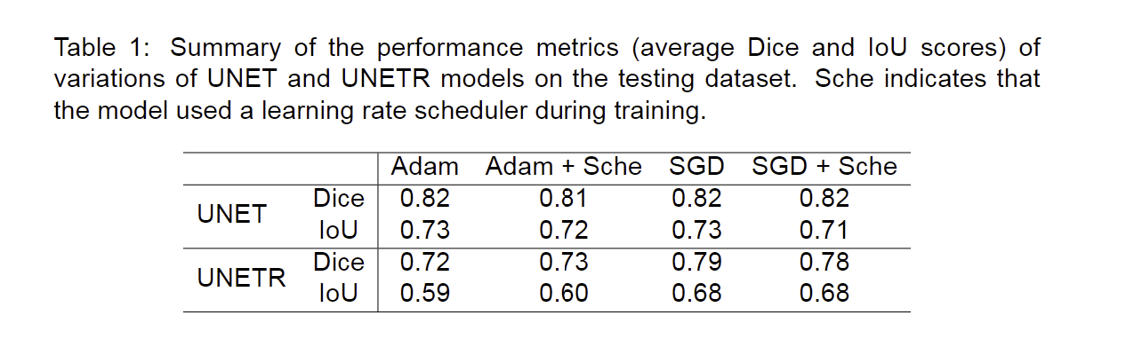
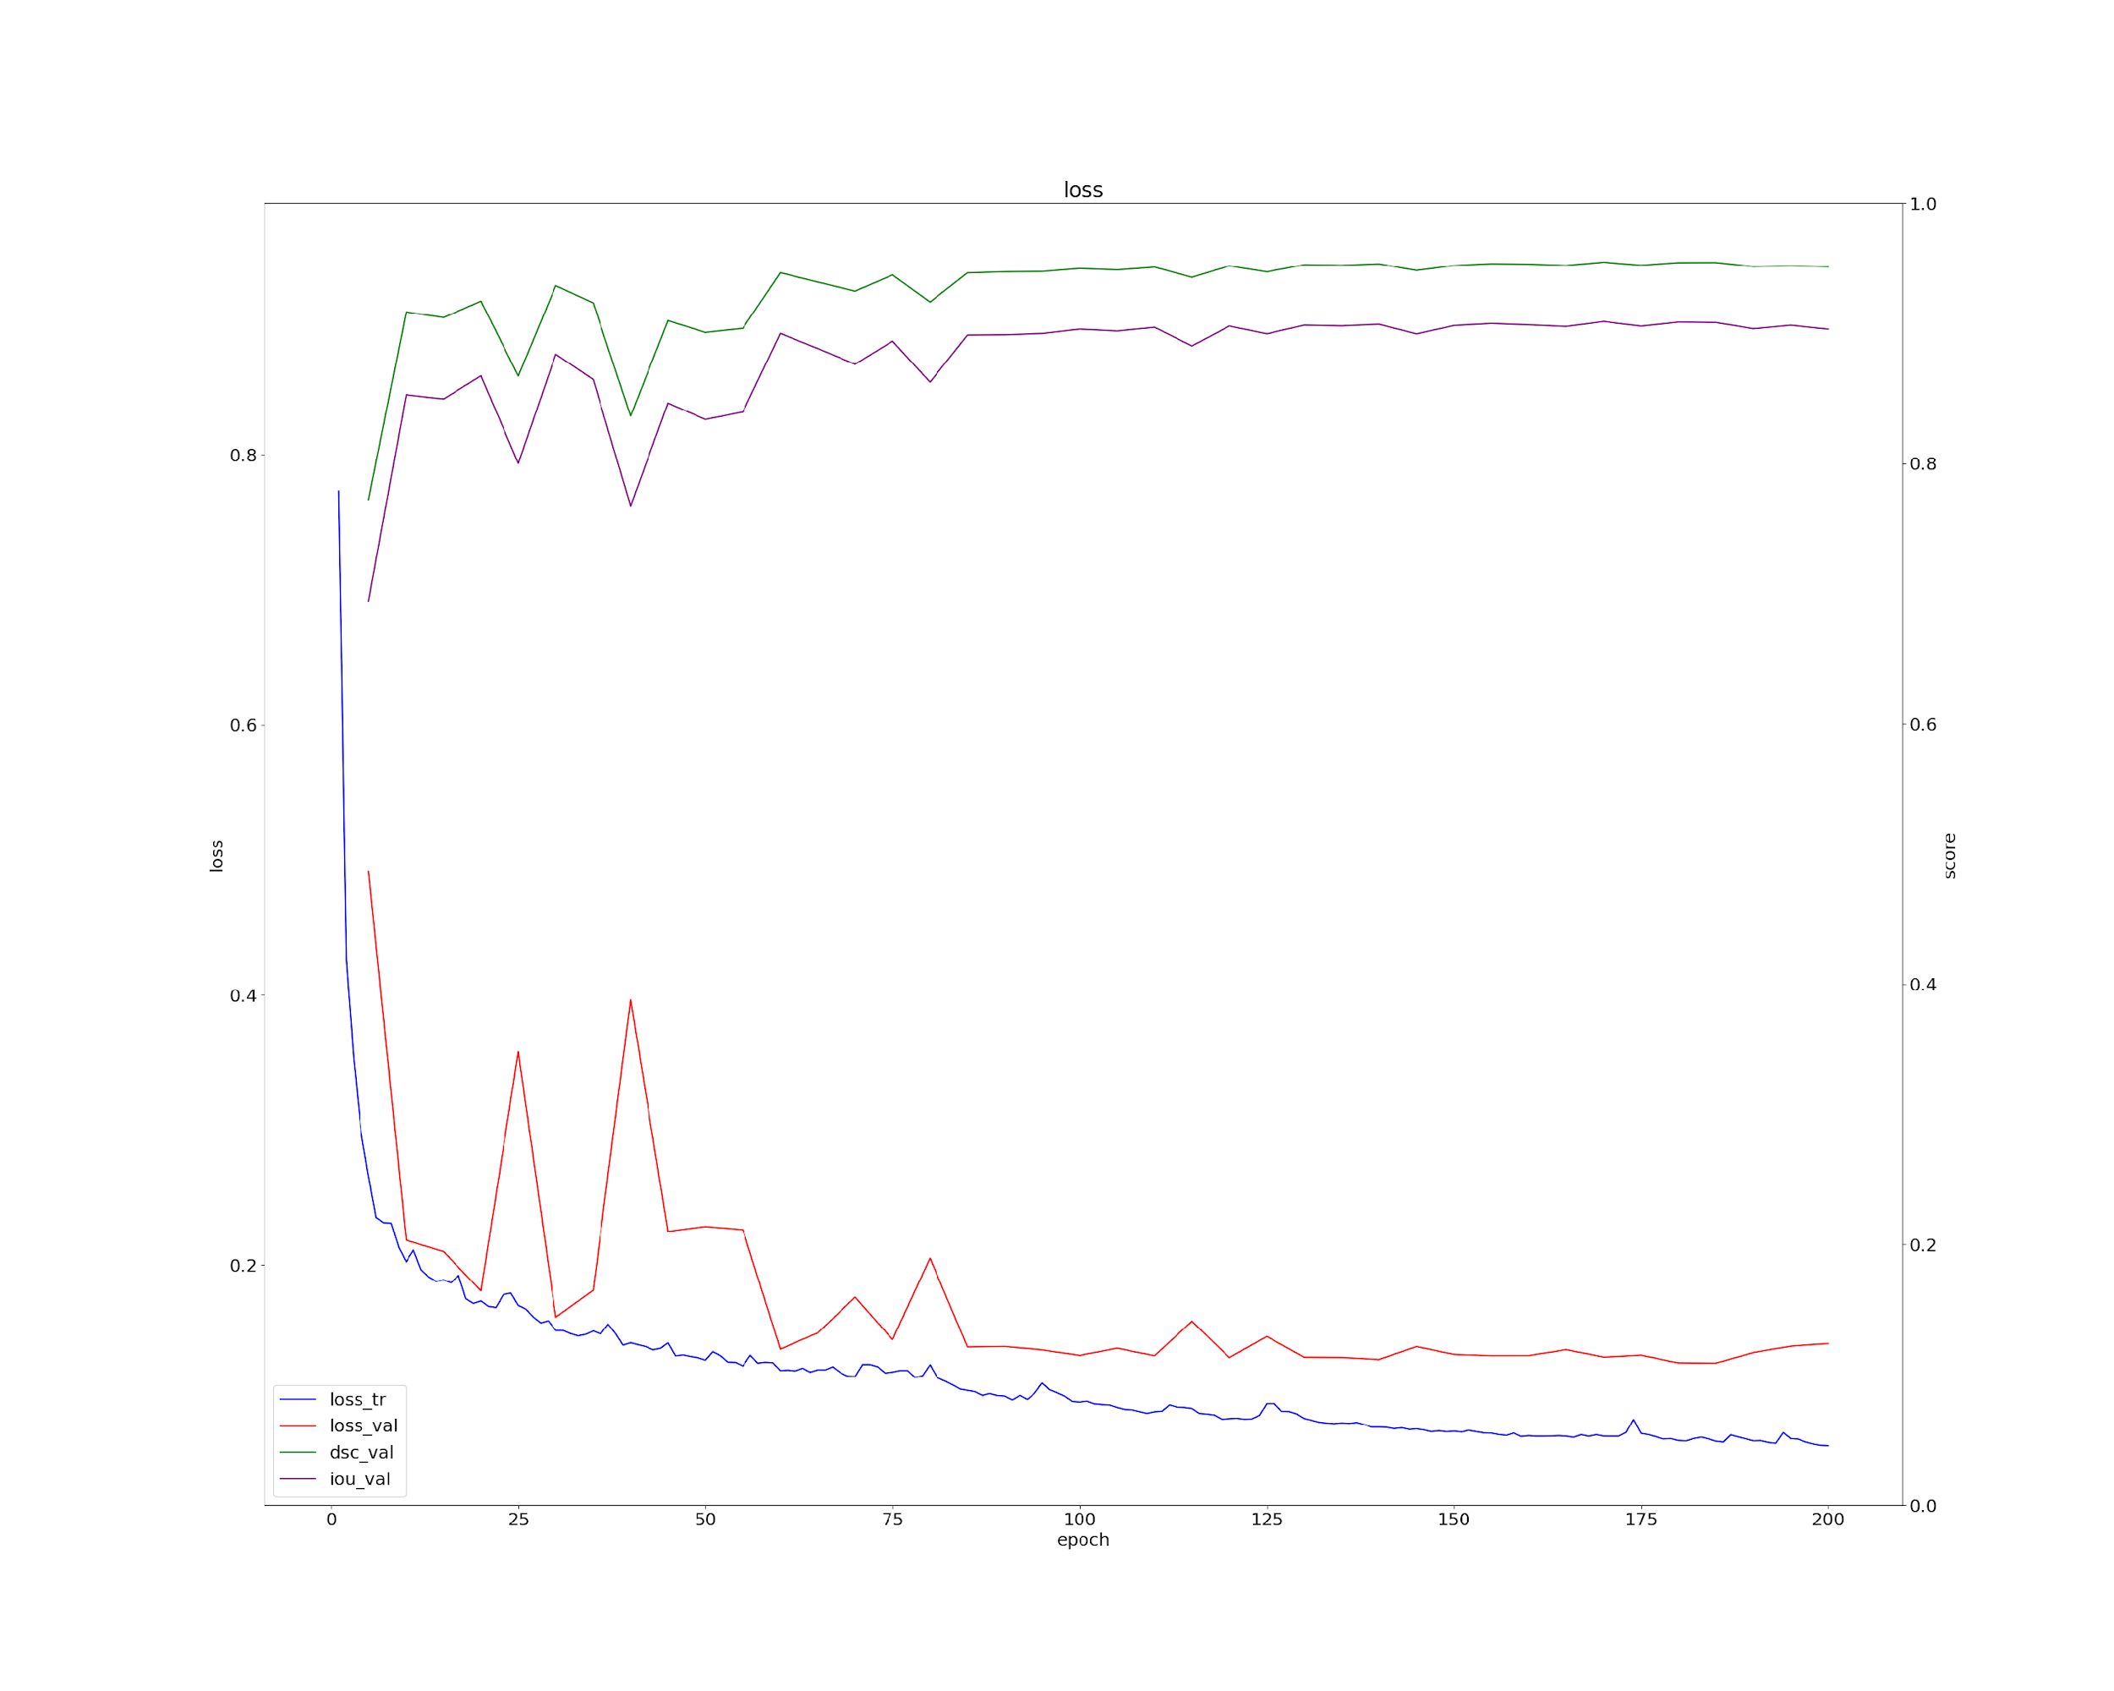
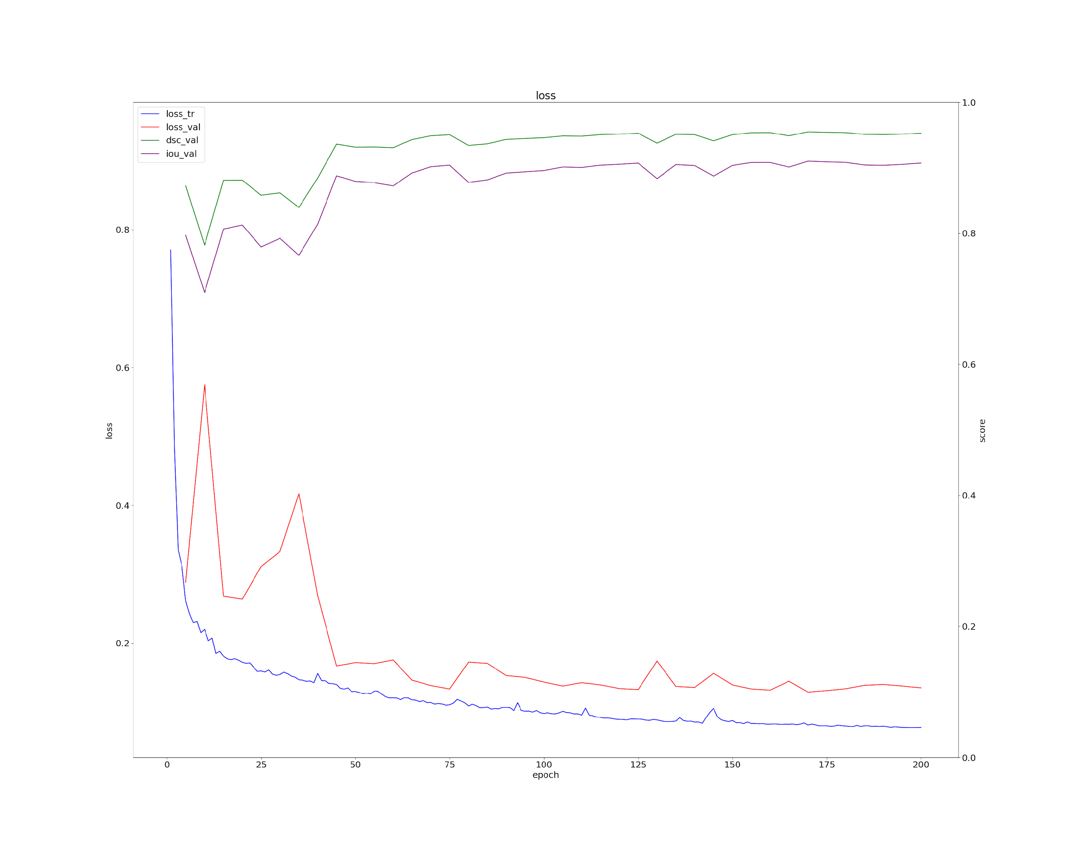
Adam converges faster for UNET but does not improve testing metrics
(a)
Original
(b)
Learning rate scheduler
Adam
(c)
(d)
SGD
Notes:
blue - training loss
red: validation loss
green: validation dice score
purple: validation IoU score
Adam is an adaptive algorithm that optimizes the learning rate for each parameter in the model individually based on the first and second moments of the gradients. this faster optimization can cause the model to not be very generalizable, as the testing performance does not improve

Slide 19
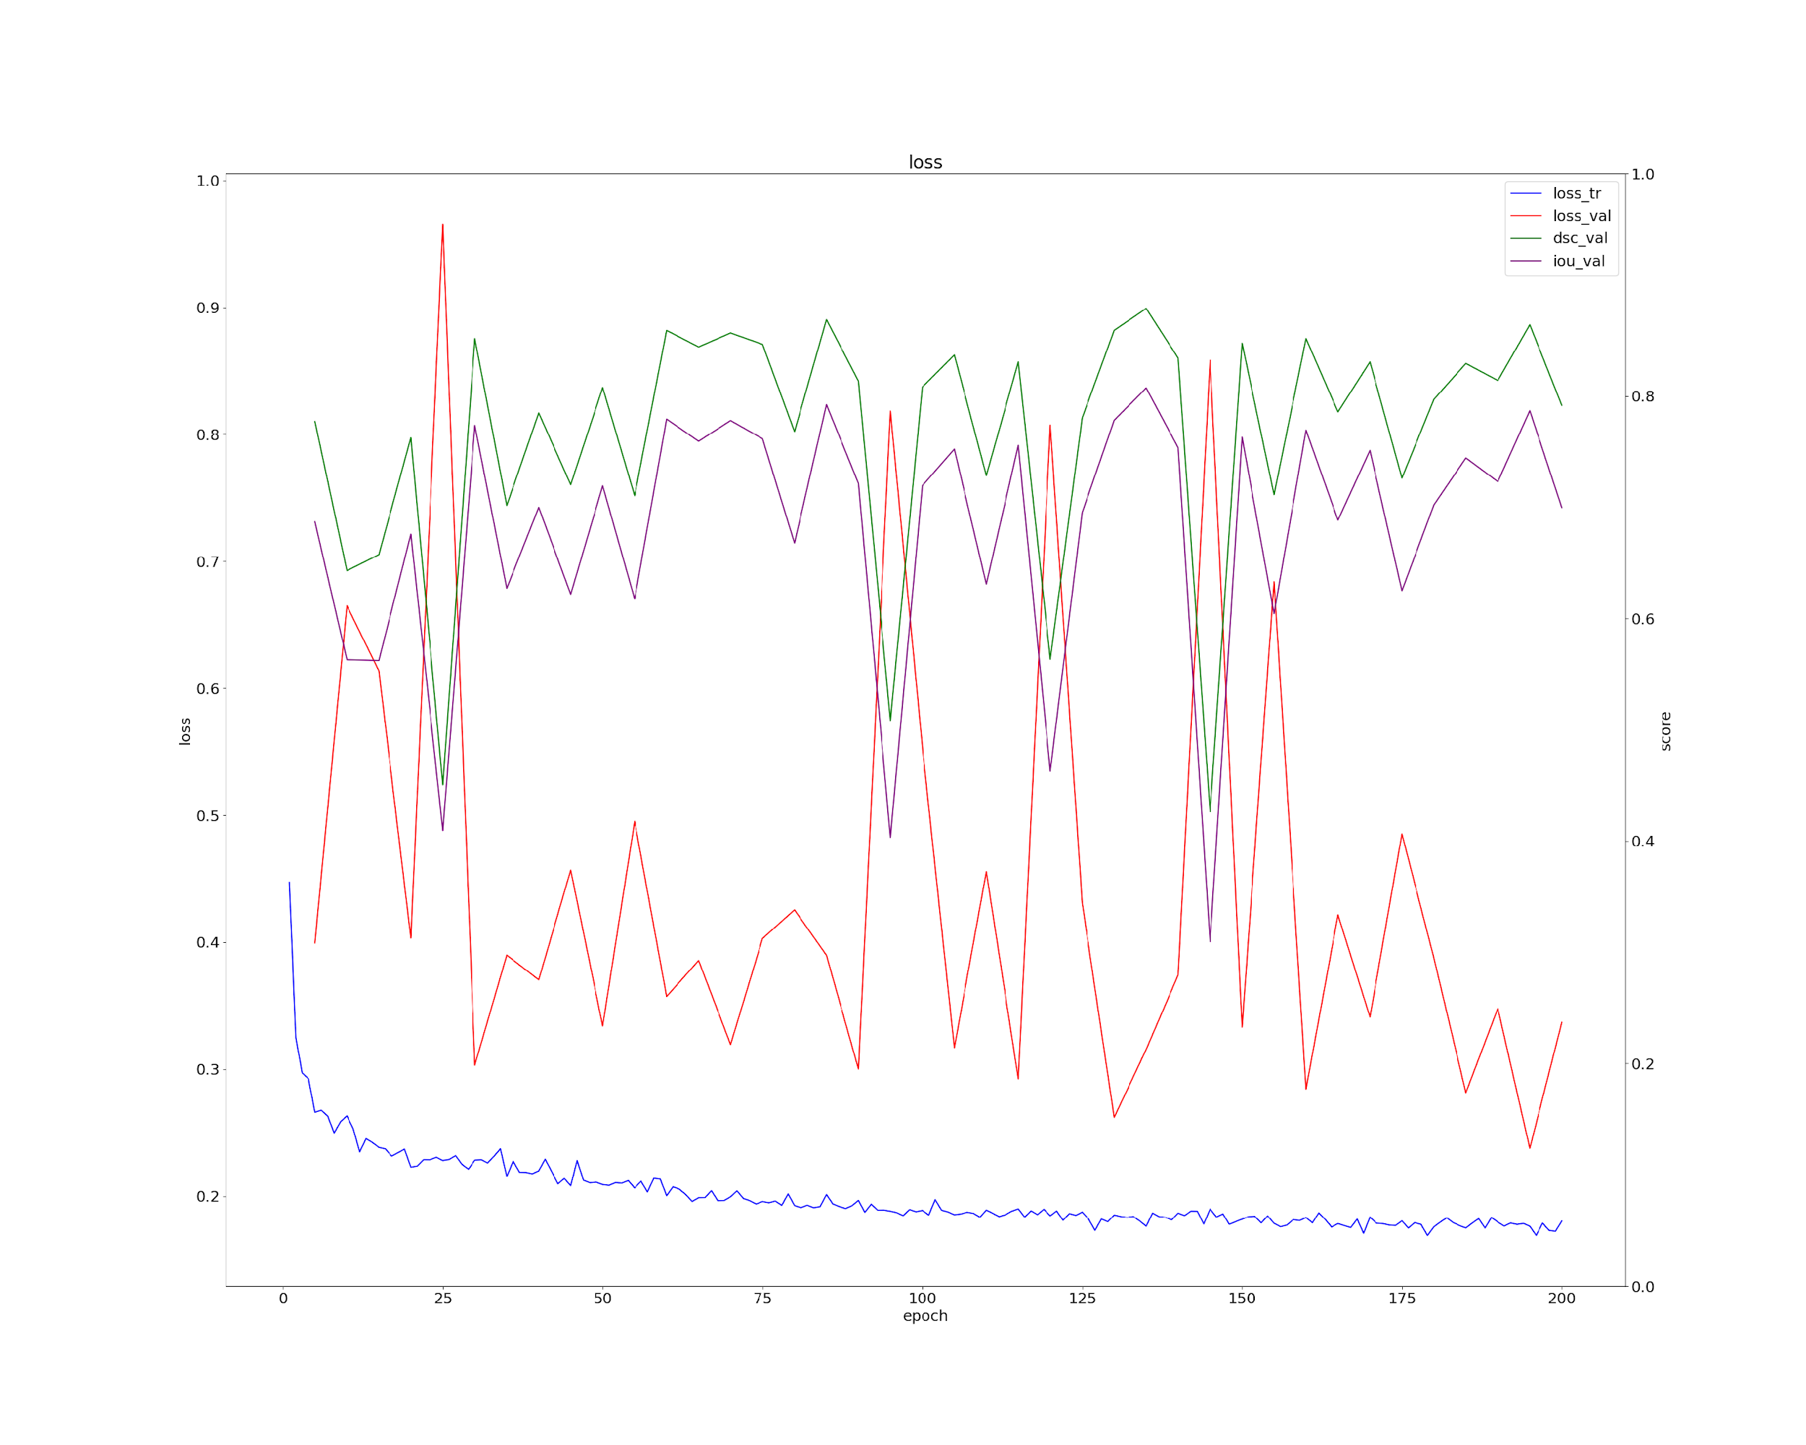
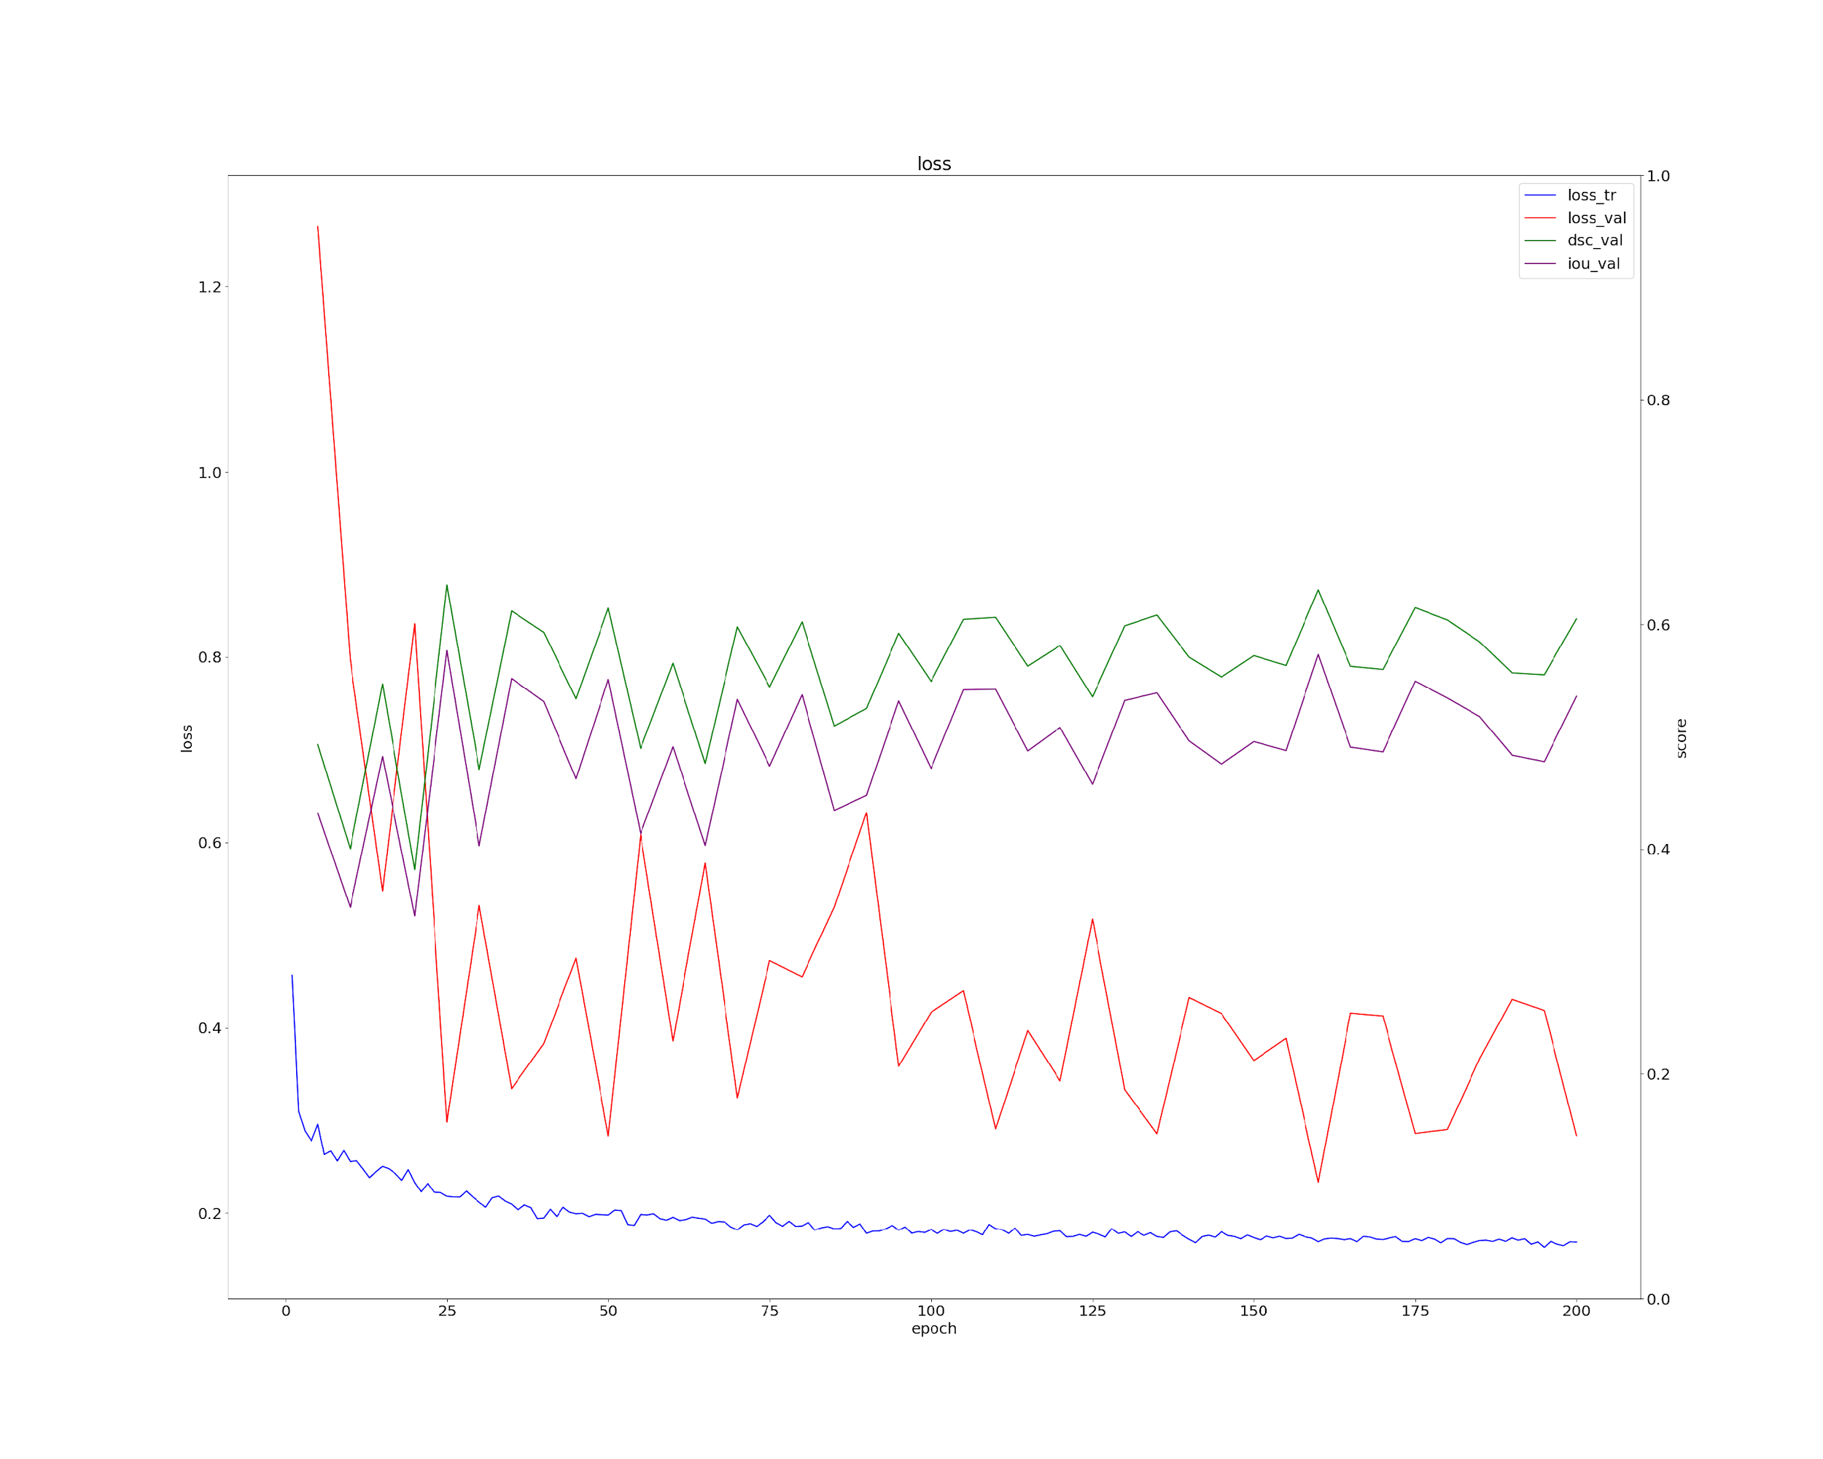
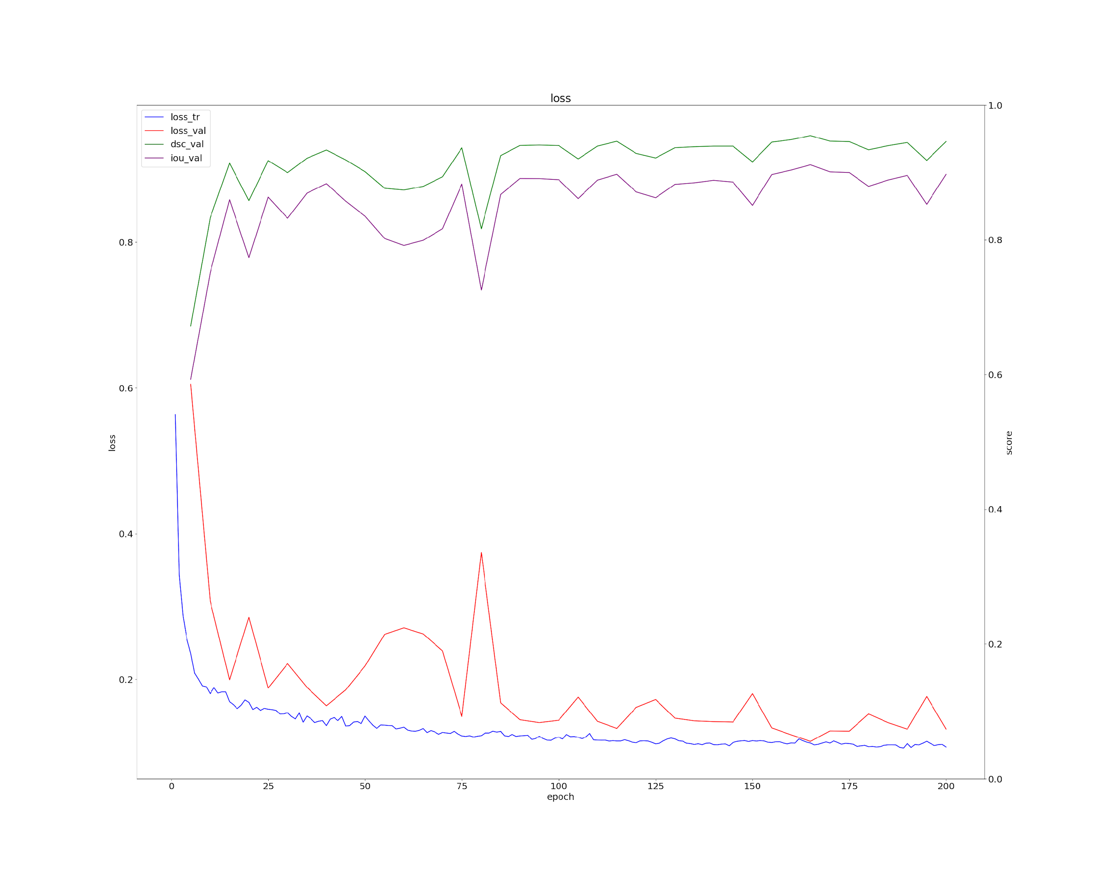
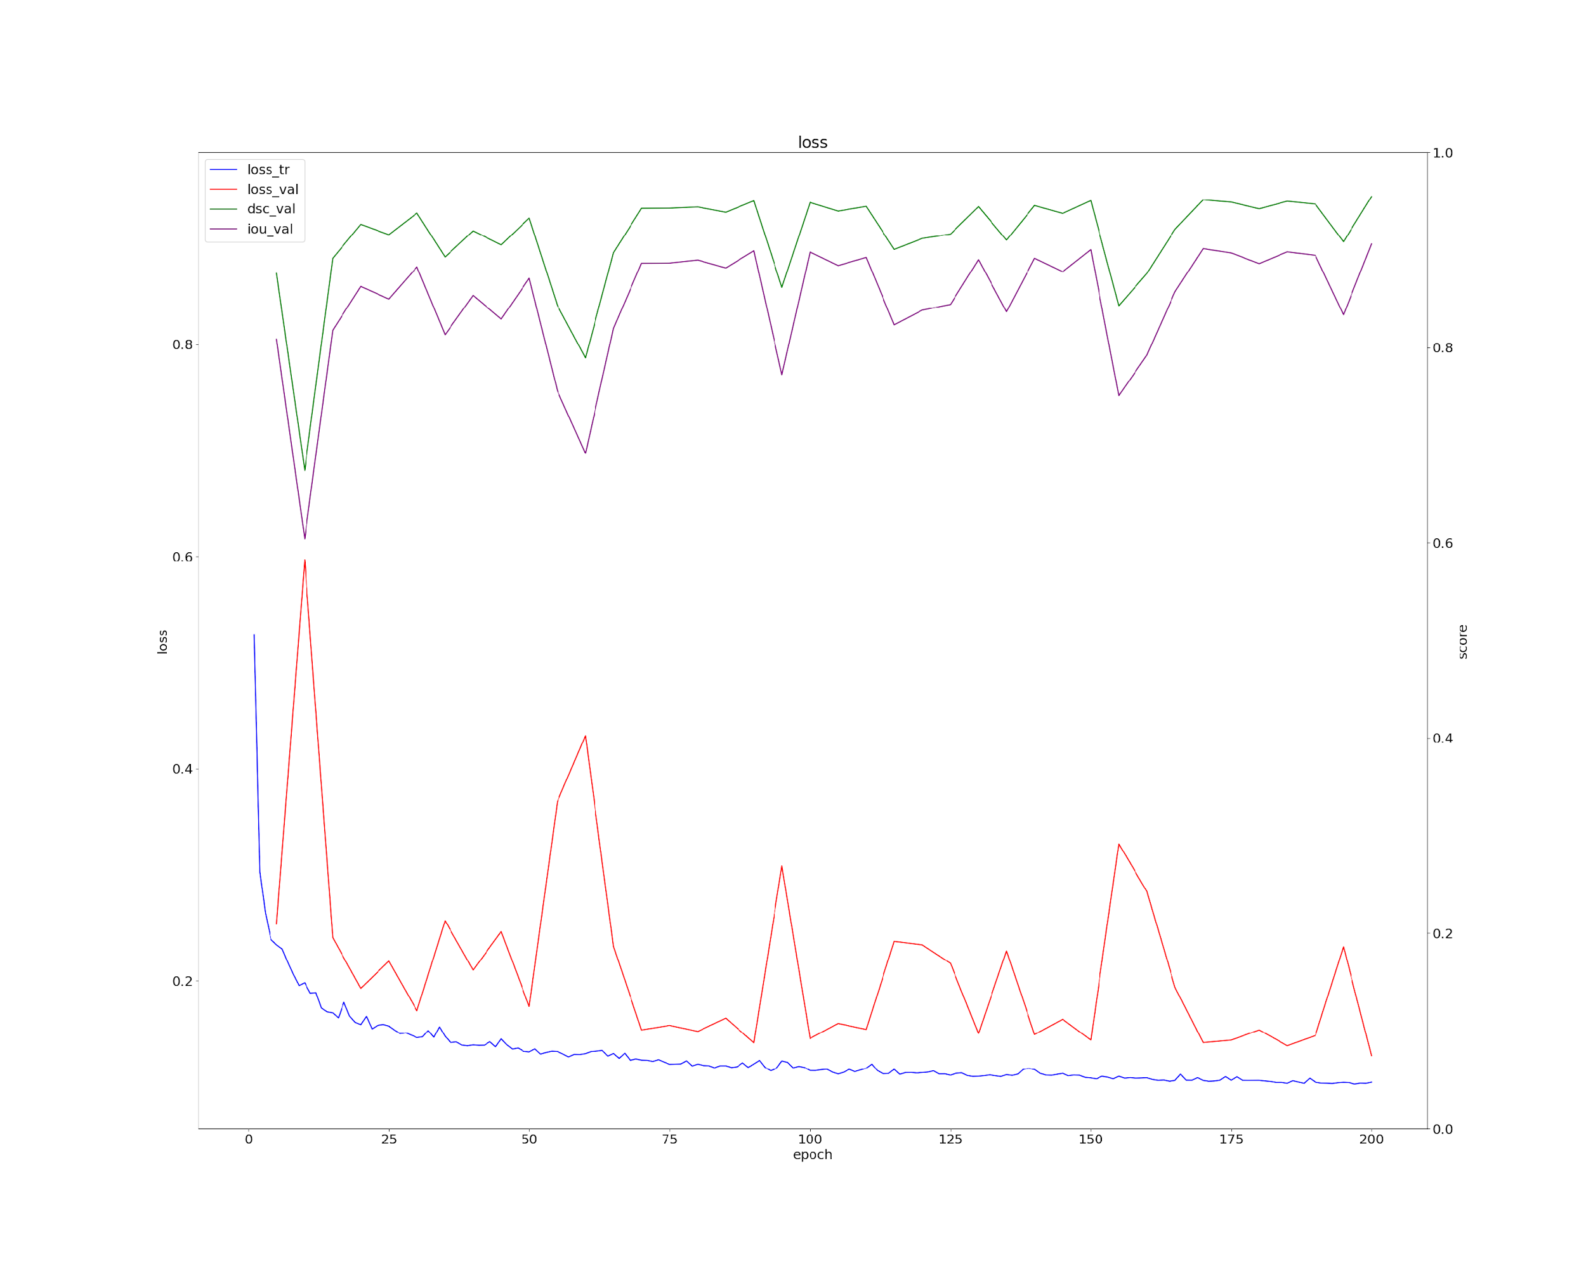
SGD makes training more stable for UNETR models and allows for better testing performance
Original
Learning rate scheduler
(a)
(b)
Adam
(c)
(d)
SGD
Notes:
we hypothesize that the small sample size of only 670 images for training makes the first and second moments of the gradients to be noisy, which might explain why SGD performs significantly better for UNETR models.

Slide 20
Learning rate scheduler has limited if not negative impact on model testing performance
Notes:
Studies have shown that the choice of the learning rate scheduler should depend on the characteristics of the dataset to maximize its benefit
For a dataset with class imbalance, should use a more aggressive lr

Slide 21
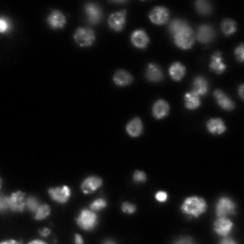
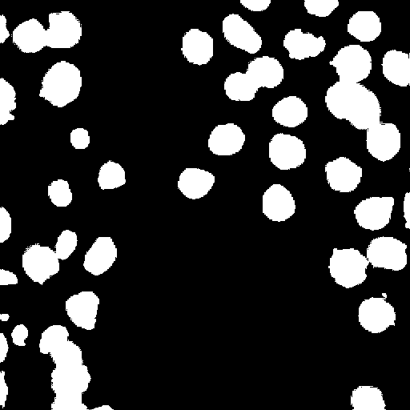

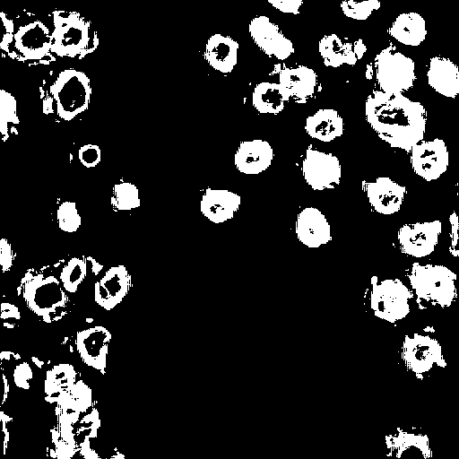

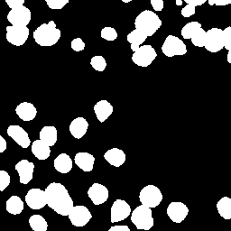
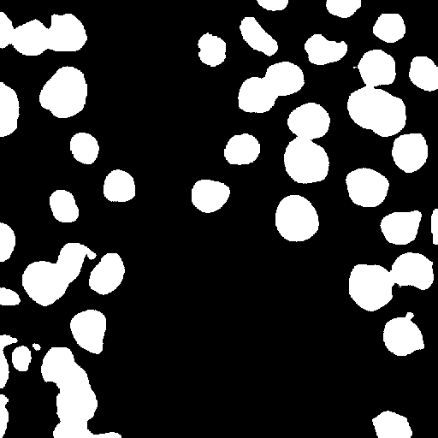
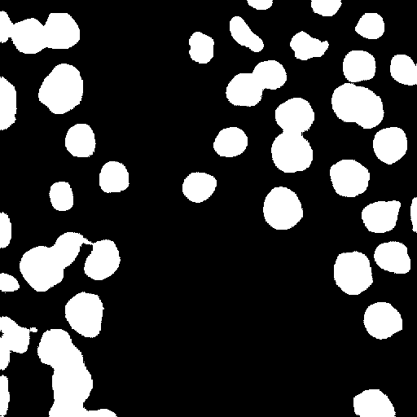
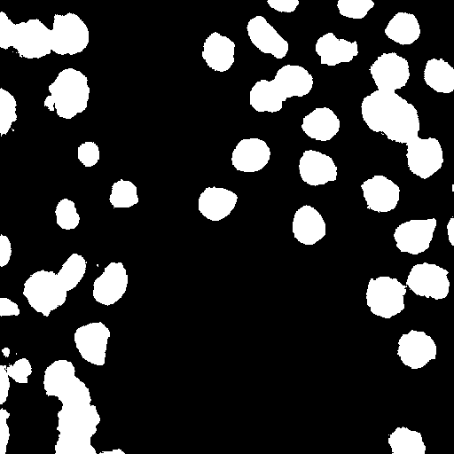
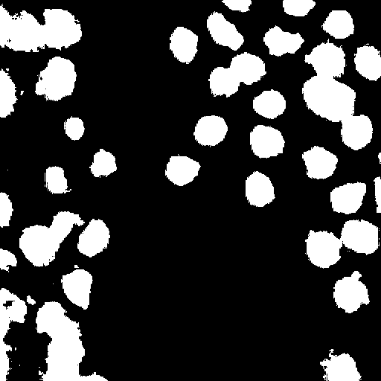
UNET has overall better performance than UNETR
(ai)
(b)
(c)
(ai)
(b)
(c)
(aii)
(d)
(e)
(aii)
(d)
(e)
UNET
UNETR
Notes:
Mention that ViT needs large dataset
The primary reason for that is that studies have found that vision transformer-based models (such as UNETR with its attention-based encoder) suffer from performance issues on small datasets. This is because when the dataset is small, vision transformers often fail to learn the local features, despite that those features are learnable when the dataset becomes larger

Slide 22
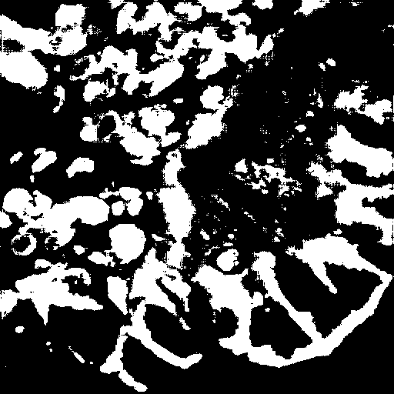
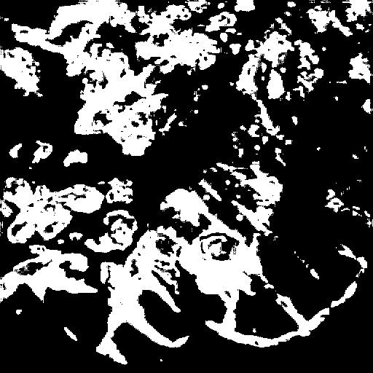
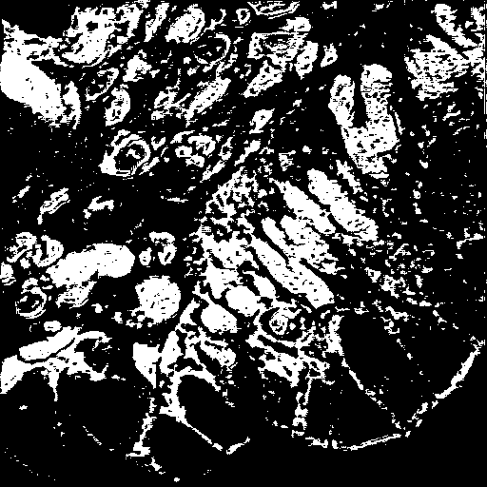
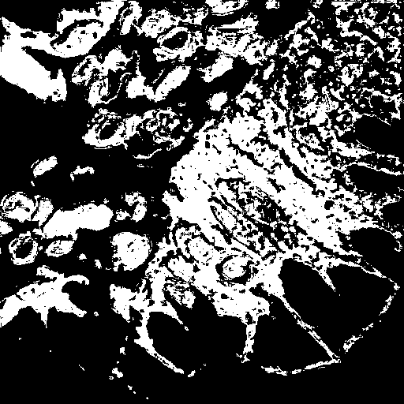
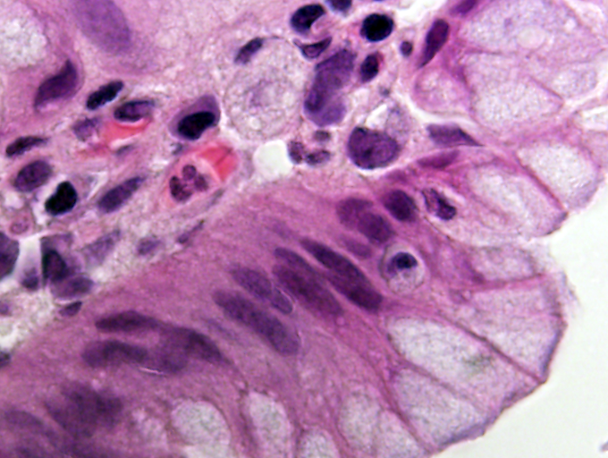
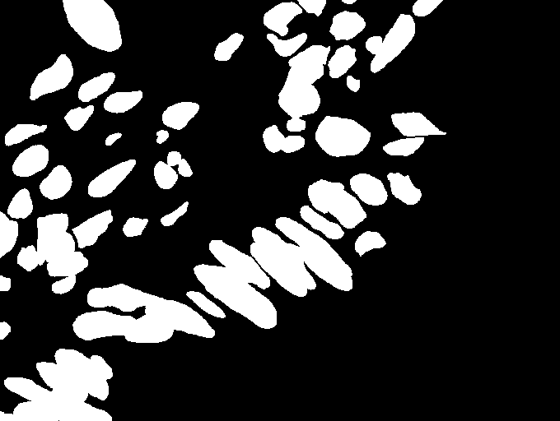
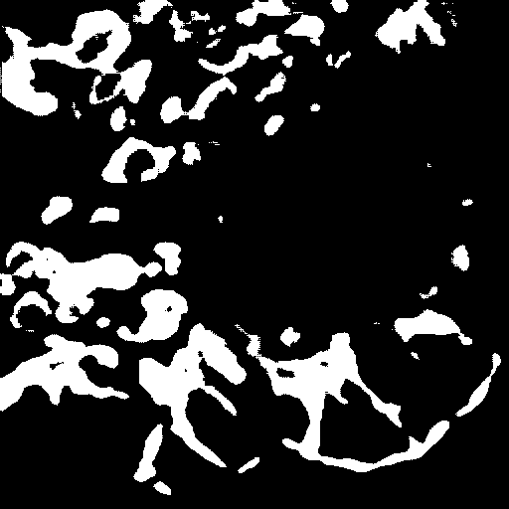
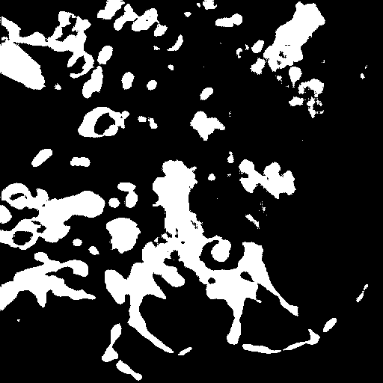
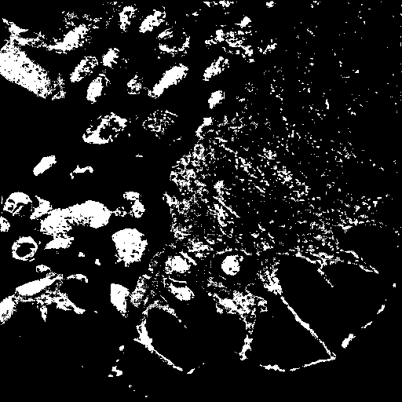
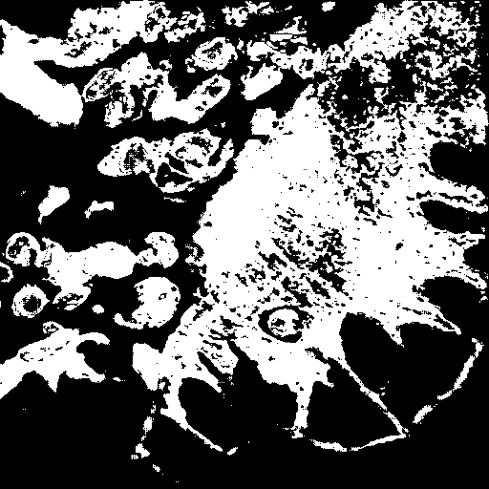
Both models did not do well with stained images
(b)
(c)
(b)
(c)
(ai)
(ai)
(aii)
(d)
(e)
(aii)
(d)
(e)
UNET
UNETR
Notes:
Our training dataset has way more non-stained images than stained images

Slide 23
Conclusion
How can future researchers design cell segmentation models?

Slide 24
With a small and unbalanced dataset…
UNET with SGD has the best performance while also require relatively low training resources
LR scheduler can be helpful if it is tuned properly
A bigger and more balanced dataset is always welcomed!
Dataset should be exclaimed closely to choose the best tools for training

Slide 25
Thank you!

Slide 26
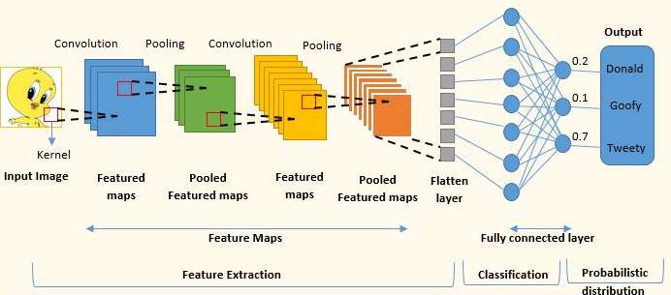
Convolutional Neural Network (CNN)
Notes:
Start with ML or CNN?
https://www.analyticsvidhya.com/blog/2022/01/convolutional-neural-network-an-overview/
a convolutional neural network (CNN) is one of the architectures to aid cell segmentation as it can learn more local information while also reducing the number of required parameters so that the learning process is more efficient \cite{kattenborn2021review}. In general, the input for CNN is an image or grid-like structure, and each pixel is represented as a numeric value as greyscale or RGB/RGBA \cite{ihor2024malware}. In the middle of the pipeline, there are several convolutional layers as building blocks which are made up of convolutional kernels that cut the image into pieces and filter slides that multiply the local image into a feature map \cite{albawi2017understanding}. After the convolution operation, an activation function is applied element-wise to involve non-linearity and help to capture features in the image \cite{hao2020role}. The feature maps will be further reduced with the pooling layer but the important information will remain, and the final feature maps will be flattened into one vector to pass for further processing in the fully connected layer \cite{kattenborn2021review}. This layer performs the learning with high-level reasoning and decision-making \cite{basha2020impact}. After learning, the output layer can represent the predicted values, and the network is tested on new input data to evaluate its performance.

Slide 27
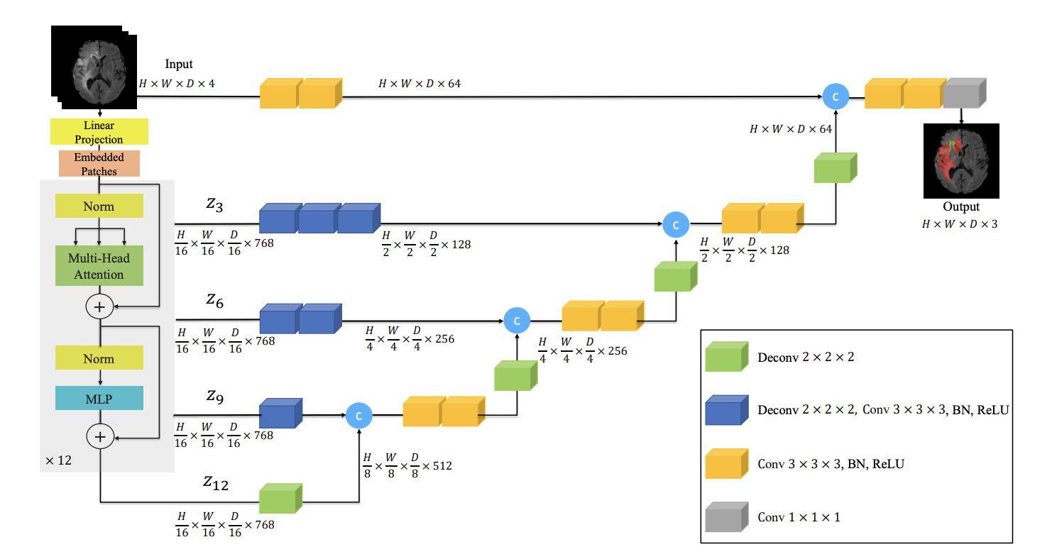
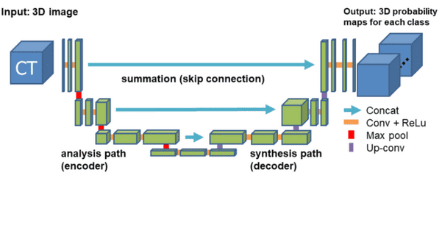
UNET and UNETR
UNET
UNET transformer (UNETR)
Notes:
R
ased on the UNET architecture, UNET transformer (UNETR) was proposed later by Ben-Cohen et al., which uses a transformer-based approach that enhances the scalability of the original UNET
uses transformer attention method

